Slide 1
資料分析
Data Analysis Process
Use case: james_bond_data.csv

Slide 2
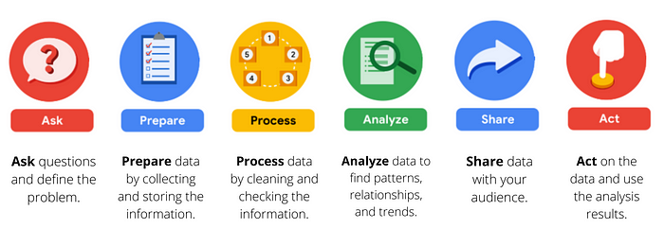
Six Phases of Google Data Analysis

Slide 3
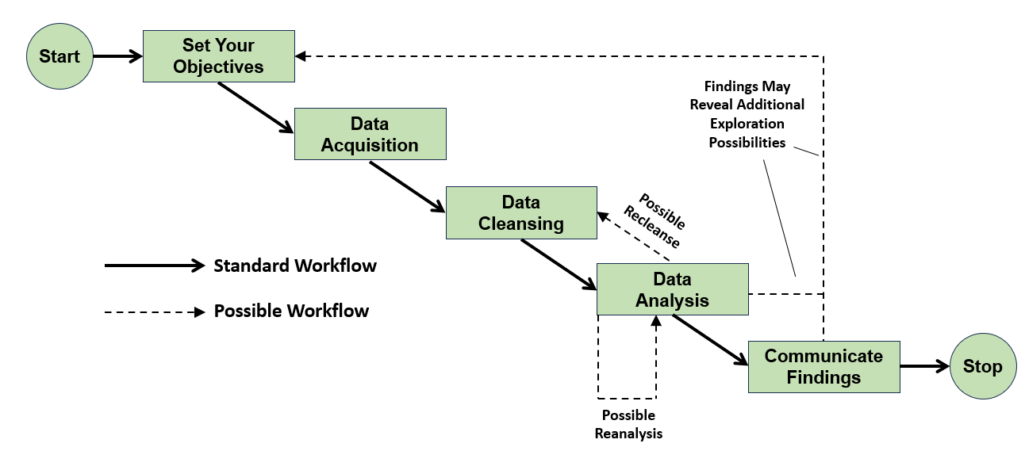
A Data Analysis Workflow
Use case: james_bond_data.csv

Slide 4
(1) Set Your Objectives
Objective: problem-solving, define the business problem and involved stakeholder
Examples of problem statement
了解組織如何提高新員工的留任率
了解客戶滿意度如何影響我們在線商店的回客率和營收
了解貸款者屬性和貸款內容如何影響貸款核准與否
了解班級規模對學習成績的影響
James Bond movie dataset 可以回答有關 007電影的問題，包括：
Is there any relationship between the Rotten Tomatoes ratings and those from IMDb?
Are there any insights to be gleaned from analyzing the lengths of the movies?
Is there a relationship between the number of enemies James Bond has killed and the user ratings of the movie in which they were killed?

Slide 5
(2) Prepare
Objective: collect and store data set
Collect data
問卷
網路爬蟲收集外部資料
銷售資料庫
機台監測數據
Store
檔案系統 (TXT, CSV, JSON)
資料庫 (SQL, NoSQL)
Prepare 資料集
檔案可從Google Drive 下載 "https://drive.google.com/uc?id=19Dq2YUJZHNbfUVIOXVQnMSVzKxL-Zew3"
或是在E3上,檔名為 james_bond_data.csv
Move the cvs file to Google drive for CoLab or keep it in local for Thonny
import requests
from pathlib import Path
downloadurl = "https://drive.google.com/uc?id=19Dq2YUJZHNbfUVIOXVQnMSVzKxL-Zew3"
target_csv_path = Path.cwd() / 'demo source files' / 'james_bond_data.csv'
response = requests.get(downloadurl)
if response.status_code == requests.codes.ok:
with target_csv_path.open(mode='wb') as file:
file.write(response.content)
print("Download ready.")
else:
print("Can NOT download.")

Slide 6
資料集內欄位名稱
Heading | Meaning
Release | The release date of the movie
Movie | The title of the movie
Bond | The actor playing the title role
Bond_Car_MFG | The manufacturer of James Bond’s car
US_Gross | The movie’s gross US earnings
World_Gross | The movie’s gross worldwide earnings
Budget ($ 000s) | The movie’s budget, in thousands of US dollars
Film_Length | The running time of the movie
Avg_User_IMDB | The average user rating from IMDb
Avg_User_Rtn_Tom | The average user rating from Rotten Tomatoes
Martinis | The number of martinis that Bond drank in the movie
Kills_Bond | The number of killed enemies

Slide 7
(3) Process – 觀察數據集的組成
Objective: clean data, transform data, check data quality
Process data
空值的處理
去除重複資料
資料內容的置換
調整資料格式
異常值處理
避免垃圾進，垃圾出
Process 資料集
了解資料集結構
df.shape
df.head() / df.head(10) / df.tail() / df.tail(10)
基本統計 (basic statistics) 來觀察數據分佈
df.info()
df.describe() # basic statistics for all int, float columns

Slide 8
(4) Analysis
Objective: find pattern, relationship, trend and noisy
Analysis methods
敘述統計來測量樣本和對有關的內容提供簡單的總結 (summary statistics), 比如 mean, median, variance, range,..
線性回歸
資料分類和分群
決策樹分析
機器學習演算法
時間序列分析

Slide 9
(5) Share
Objective: data-driven storytelling, communication with stakeholder
Communication
資料視覺化
Dashboard and charting

Slide 10
(6) Act
Objective: according to analysis result to take actions

Slide 11
Taking Actions Based on Data Analysis Result
New buy tool
Few data
Small data
EDA
EDA (Exploratory Data Analysis, 探索式資料分析)
Data Process
Fab製程工程師
Fab設備工程師
IT資料分析師
IT資料科學家
Good enough data cleaning method
Good enough data analysis methods
Large Data
Good enough data cleaning method
IT資料分析師
IT資料科學家
持續分析
Take Action by Fab Engineer
IT資料工程師

Slide 12
Backup

Slide 13
Bin(4) Illustration

Slide 14
#Lab 分析教室規模對於測驗分數的影響 (/GoogleDrive/myDrive/資料分析案例實作/star/star.ipynb)
這個資料集我們將用來檢驗教室規模對於測驗分數的影響, 每個樣本都包含以下欄位
Tmathssk: 數學量表分數總和
Treadssk: 閱讀量表分數總和
classk : 課程類型
small class: 13 to 17 students per teacher
regular class: 22 to 25 students per teacher
regular-with-aide class: 22 to 25 students with a full-time teacher's aide
Totexpk: 教師的教學總年資
Sex: 學生性別
Freelunk: 是否符合免費午餐資格
Race: 族裔
Schidkn: 學校評鑑指標名次

Slide 15
EDA (Exploratory Data Analysis, 探索式資料分析)
EDA 是一套包含資料處理，資料分析， 資料視覺化及統計等技術的數據分析方法， 其主要目的是從各個面向探索數據，找出回答已定義問題的線索，並進一步確認各面向間關聯，以合適的圖表與關係利害人溝通。
EDA 通常沒有固定可依循的步驟，而是以一連串的啟發式的提問-回答的循環逐漸的釐清問題的核心，從數據中挖掘對問題深度的見解 (insights)
EDA 常用的基本技能
觀察數據集組成
數據處理
數據視覺化
基礎統計
數據分析文件化

